Slide 1

Introduction to IT Project Management and Entrepreneurship
Lecture 6
Deepak Chandra Roy
Adjunct Faculty, CSE, EWU
deepak.kth@gmail.com
01685441156
1
CSE-495, Section# 3
*
Notes:
1

Slide 2
Agenda
Software Costing

Slide 3
Costing
Profit margin is a financial metric that represents the percentage of revenue that exceeds the costs associated with producing and delivering a product or service. It is a key indicator of a company's profitability and is expressed as a percentage. The profit margin is calculated by dividing the net profit by the total revenue and multiplying by 100 to express it as a percentage.
There are three different types of profit margins:
Gross profit margins
Operating profit margins
Net profit margins
Notes:
https://www.investopedia.com/ask/answers/031815/what-formula-calculating-profit-margins.asp
3

Slide 4
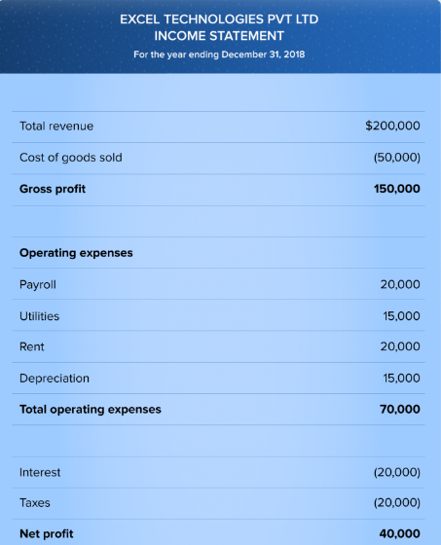
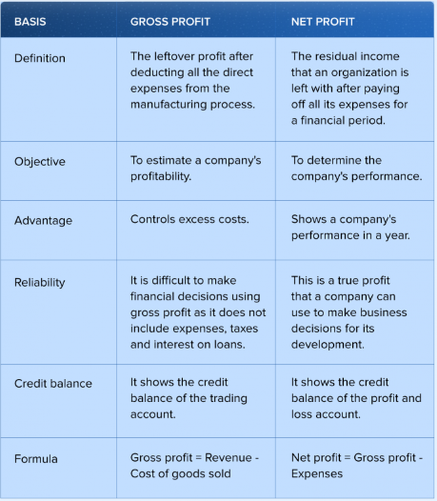
Costing cont..
Notes:
A profit and loss account records all the incomes and expenses that have taken place in the year. All the expenses are recorded on the debit side whereas all the incomes are recorded on the credit side. When the credit side is more than the debit side it denotes profit. Hence, Credit balance of Profit and loss account is profit.
4

Slide 5
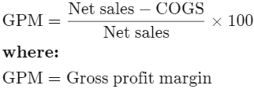
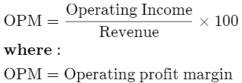
Costing cont..
Gross Profit Margin:
Calculates the percentage of revenue that exceeds the cost of goods sold (COGS).
Operating Profit Margin:
Reflects the percentage of revenue that remains after deducting operating expenses.

Slide 6
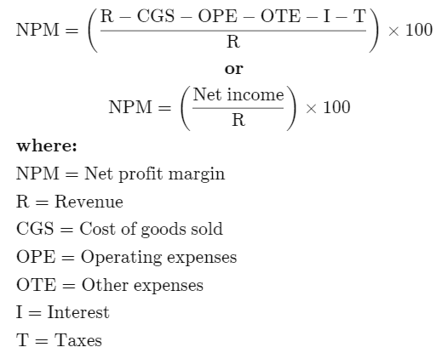
Costing cont..
Net Profit Margin:

Slide 7
Software Costing
Software costing involves estimating and determining the expenses associated with developing, deploying, and maintaining software throughout its lifecycle. Properly understanding and managing software costs is crucial for budgeting, resource allocation, and project planning.

Slide 8
Key components and considerations in software costing
Development Costs
Infrastructure Costs
Testing Costs
Deployment Costs
Maintenance Costs
Project Management Costs
License and Subscription Costs
Documentation Costs
Overhead Costs
Contingency and Risk Management

Slide 9
Development Costs
Labor Costs: Estimate the time and effort required from development teams, including analysts, programmers, testers, and project managers. Consider hourly rates or salaries.
Tool and Technology Costs: Include expenses related to development tools, integrated development environments (IDEs), and any specialized software or licenses required.

Slide 10
Infrastructure Costs
Hardware Costs: Include expenses for servers, workstations, and any specialized hardware needed for development or deployment.
Software Licenses: Account for the cost of licenses for operating systems, databases, and other software components.

Slide 11
Testing Costs
Testing Tools: Estimate the costs associated with testing tools, automation frameworks, and any third-party testing services.
Quality Assurance (QA) Team Costs: Consider the time and effort invested by QA professionals in testing and quality control.

Slide 12
Deployment Costs
Deployment Tools: Include costs for deployment automation tools and scripts.
User Training: Estimate the costs associated with training end-users on how to use the software.

Slide 13
Maintenance Costs
Support and Maintenance: Consider ongoing expenses related to bug fixes, updates, and user support.
Enhancements: If planned, estimate the costs of adding new features or making improvements to the software.

Slide 14
Project Management Costs
Project Manager Costs: Account for the time and effort invested by project managers in planning, coordination, and communication.
Contingency Planning: Allocate a percentage of the budget for unforeseen issues or changes.

Slide 15
License and Subscription Costs
Third-Party Services: Include costs associated with third-party APIs, cloud services, or any external services used by the software.

Slide 16
Documentation Costs
Documentation Tools: Include costs related to creating user manuals, technical documentation, and help systems
In some cases, organizations may choose to categorize documentation costs separately. This could be done for better tracking and visibility of expenses related specifically to documentation efforts.
In this scenario, documentation costs would still be part of the broader software development budget, but there would be a dedicated breakdown for documentation within that budget.
Ultimately, the choice of how to categorize documentation costs may depend on the organization's accounting practices, project management approach, and the level of granularity they want in tracking expenses. It's common for documentation costs to be closely associated with development costs since they are integral to delivering a complete and usable software product. However, organizations may tailor their cost structures based on their specific needs and reporting preferences.

Slide 17
Overhead Costs
Facility Costs: Consider rent, utilities, and other facility-related expenses.
General Administrative Costs: Include administrative overhead such as office supplies and general support services.

Slide 18
Contingency and Risk Management
Allocate a portion of the budget for unexpected risks or changes in project scope.
Regularly reassess and update the budget as the project progresses.

Slide 19
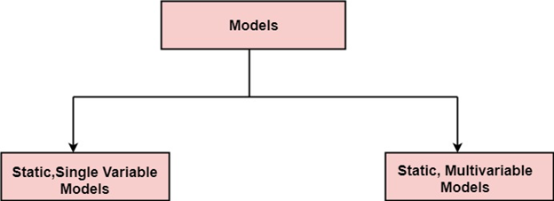
Software Cost Estimation
A model may be static or dynamic. In a static model, a single variable is taken as a key element for calculating cost and time.
In a dynamic model, all variable are interdependent, and there is no basic variable.

Slide 20
Single-Variable Vs Multi-Variable
The terms "static single-variable" and "static multi-variable" refer to different characteristics of software cost estimation models, particularly in terms of their flexibility and the number of factors considered in the estimation process.
Static Single-Variable Model:
Static: This implies that the model does not change over time or in response to new information. It provides estimates based on fixed input parameters.
Single-Variable: This means that the estimation process relies on only one input parameter or factor. For example, a static single-variable model might estimate software development effort solely based on the size of the project, such as lines of code or function points.
In summary:
Static models do not change over time and provide fixed estimates.
Single-Variable models rely on one input parameter for estimation.
Multi-Variable models consider multiple input parameters in the estimation process.
The choice between a static single-variable model and a static multi-variable model depends on the specific needs of a project and the available data. While more variables may contribute to a more nuanced and accurate estimation, they also require more data and may be more complex to implement. It's essential to strike a balance between simplicity and capturing the essential factors influencing the project's cost.

Slide 21
Single-Variable Vs Multi-Variable cont..
Static Multi-Variable Model:
Static: Like the single-variable model, this suggests that the model does not dynamically adapt to changes over time. However, it still considers multiple input parameters.
Multi-Variable: This means that the estimation process takes into account more than one factor. For instance, a static multi-variable model might consider project size, team experience, complexity, and other relevant factors simultaneously to estimate effort and cost.

Slide 22
Single-Variable Vs Multi-Variable cont..
Static models do not change over time and provide fixed estimates.
Single-Variable models rely on one input parameter for estimation.
Multi-Variable models consider multiple input parameters in the estimation process.
The choice between a static single-variable model and a static multi-variable model depends on the specific needs of a project and the available data. While more variables may contribute to a more nuanced and accurate estimation, they also require more data and may be more complex to implement. It's essential to strike a balance between simplicity and capturing the essential factors influencing the project's cost.

Slide 23
Static, Single Variable Models
When a model makes use of single variables to calculate desired values such as cost, time, efforts, etc. is said to be a single variable model. The most common equation is:
C=aL^{b}
Where C = Costs L= size a and b are constants
The Software Engineering Laboratory established a model called SEL model, for estimating its software production.

Slide 24
Static, Single Variable Models cont..
This model is an example of the static, single variable model.
E=1.4L^{0.93} DOC=30.4L^{0.90} D=4.6L^{0.26}
Where E= Efforts (Person Per Month) DOC=Documentation (Number of Pages) D = Duration (D, in months) L = Number of Lines per code

Slide 25
Static, Multivariable Models
This model depends on several variables describing various aspects of the software development environment. In some model, several variables are needed to describe the software development process, and selected equation combined these variables to give the estimate of time & cost. These models are called multivariable models.
WALSTON and FELIX develop the models at IBM provide the following equation gives a relationship between lines of source code and effort:
E=5.2L^{0.91}

Slide 26

Static, Multivariable Models cont..
In the same manner duration of development is given by
D=4.1L^{0.36}
The productivity index uses 29 variables which are found to be highly correlated productivity as follows:
Where W_{i} is the weight factor for the i^{th} variable and X_{i}={-1,0,+1} the estimator gives X_{i} one of the values -1, 0 or +1 depending on the variable decreases, has no effect or increases the productivity.

Slide 27
Example
Compare the Walston-Felix Model with the SEL model on a software development expected to involve 8 person-years of effort.
Calculate the number of lines of source code that can be produced.
Calculate the duration of the development.
Calculate the productivity in LOC/PY
Calculate the average manning

Slide 28

Example cont..
The amount of manpower involved = 8PY = 8x12 = 96 persons-months
(a)Number of lines of source code can be obtained by reversing equation to give:
Then
L (SEL) = (96/1.4)^{1⁄0.93}=94264 LOC L (W-F) = (96/5.2)^{1⁄0.91}=24632 LOC

Slide 29

Example cont..
(b)Duration in months can be calculated by means of equation
D (SEL) = 4.6 (L) ^{0.26} = 4.6 (94.264)^{0.26} = 15 months D (W-F) = 4.1 L^{0.36} = 4.1 (24.632)^{0.36} = 13 months
(c) Productivity is the lines of code produced per persons/month (year)

Slide 30

Example cont..
(d) Average manning is the average number of persons required per month in the project

Slide 31
COCOMO Model
It is a dynamic software cost estimation approach
The COCOMO (Constructive Cost Model) is a well-known software cost estimation model that was initially proposed by Barry Boehm in 1981.
The COCOMO model is primarily used for estimating the cost of software development.
The COCOMO is a widely used model for estimating the effort and cost of software development projects.
COCOMO is based on the idea that the effort required for a software project is proportional to the size and complexity of the project.
Notes:
https://www.javatpoint.com/cocomo-model
31

Slide 32
COCOMO Model cont..
The necessary steps in this model are:
Get an initial estimate of the development effort from evaluation of thousands of delivered lines of source code (KDLOC).
Determine a set of 15 multiplying factors from various attributes of the project.
Calculate the effort estimate by multiplying the initial estimate with all the multiplying factors i.e., multiply the values in step1 and step2.

Slide 33
COCOMO Model cont..
The initial estimate (also called nominal estimate) is determined by an equation of the form used in the static single variable models, using KDLOC as the measure of the size. To determine the initial effort E_{i} in person-months the equation used is of the type is shown below
E_{i}=a*(KDLOC)^{b}
The value of the constant a and b are depends on the project type.

Slide 34
COCOMO Model cont..
In COCOMO, projects are categorized into three types:
Organic
Semidetached
Embedded

Slide 35
COCOMO Model cont..
Organic: A development project can be treated of the organic type, if the project deals with developing a well-understood application program, the size of the development team is reasonably small, and the team members are experienced in developing similar methods of projects. Examples of this type of projects are simple business systems, simple inventory management systems, and data processing systems.

Slide 36
COCOMO Model cont..
Semidetached: A development project can be treated with semidetached type if the development consists of a mixture of experienced and inexperienced staff. Team members may have finite experience in related systems but may be unfamiliar with some aspects of the order being developed. Example of Semidetached system includes developing a new operating system (OS), a Database Management System (DBMS), and complex inventory management system.

Slide 37
COCOMO Model cont..
Embedded: A development project is treated to be of an embedded type, if the software being developed is strongly coupled to complex hardware, or if the stringent regulations on the operational method exist.
For Example: ATM, Air Traffic control.

Slide 38
COCOMO Model cont..
Embedded: A development project is treated to be of an embedded type, if the software being developed is strongly coupled to complex hardware, or if the stringent regulations on the operational method exist.
For Example: ATM, Air Traffic control.

Slide 39
COCOMO Model cont..
For three product categories, Bohem provides a different set of expression to predict effort (in a unit of person month (PM))and development time from the size of estimation in KLOC(Kilo Line of code) efforts estimation takes into account the productivity loss due to holidays, weekly off, coffee breaks, etc.
According to Boehm, software cost estimation should be done through three stages:
Basic Model
Intermediate Model
Detailed Model

Slide 40
COCOMO Model cont..
Basic COCOMO Model: The basic COCOMO model provide an accurate size of the project parameters. The following expressions give the basic COCOMO estimation model:
Effort=a₁(KLOC)^{a2} PM Tdev=b₁(efforts)^{b2} Months
Where
KLOC is the estimated size of the software product indicate in Kilo (Thounds) Lines of Code,
a₁,a₂,b₁,b₂ are constants for each group of software products,
Tdev is the estimated time to develop the software, expressed in months
Effort is the total effort required to develop the software product, expressed in person months (PMs).

Slide 41
COCOMO Model cont..
Estimation of development effort
For the three classes of software products, the formulas for estimating the effort based on the code size are shown below:
Organic: Effort = 2.4(KLOC)^{1.05} PM
Semi-detached: Effort = 3.0(KLOC)^{1.12} PM
Embedded: Effort = 3.6(KLOC)^{1.20} PM

Slide 42
COCOMO Model cont..
Estimation of development time
For the three classes of software products, the formulas for estimating the development time based on the effort are given below:
Organic: Tdev = 2.5(Effort)^{0.38} Months
Semi-detached: Tdev = 2.5(Effort)^{0.35} Months
Embedded: Tdev = 2.5(Effort)^{0.32} Months

Slide 43
Example
Suppose a project was estimated to be 400 KLOC. Calculate the effort and development time for each of the three model i.e., organic, semi-detached & embedded.
Solution: The basic COCOMO equation takes the form:
Effort=a₁*(KLOC)^{a2} PM Tdev=b₁*(efforts)^{b2} Months Estimated Size of project= 400 KLOC

Slide 44
Example cont..
(i)Organic Mode
E = 2.4 * (400)^{1.05} = 1295.31 PM D = 2.5 * (1295.31)^{0.38}=38.07 Months
(ii)Semidetached Mode
E = 3.0 * (400)^{1.12}=2462.79 PM D = 2.5 * (2462.79)^{0.35}=38.45 Months
(iii) Embedded Mode
E = 3.6 * (400)^{1.20} = 4772.81 PM D = 2.5 * (4772.8)^{0.32} = 38 Months

Slide 45
Example 2
A project size of 200 KLOC is to be developed. Software development team has average experience on similar type of projects. The project schedule is not very tight. Calculate the Effort, development time, average staff size, and productivity of the project.
Solution: The semidetached mode is the most appropriate mode, keeping in view the size, schedule and experience of development time.
Hence E=3.0(200)^{1.12}=1133.12PM D=2.5(1133.12)^{0.35}=29.3Months

Slide 46
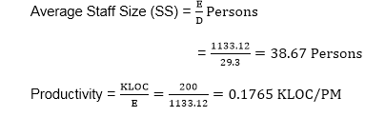
Example 2 cont..

